Slide 1
Gamification and Web Design

Slide 2
Gamification and Web Design
The gaming industry is huge
A game can keep people occupied for a long period of time
I want my websites to affect users in the same way!
I want my teaching to affect students in the same way!

Slide 3
Games and gamification
Using game theories in areas not otherwise associated with games is often referred to as gamification
Negative
People tend to use gamification for the wrong purposes.
Used in marketing with no other goal than to sell products.
Positive
Gamification should be used to improve the experience of buying and using a product.

Slide 4
Definition of a game
“a series of interesting choices.”
Or what's between the choices:
exploring new areas
learning how to control your character
pulling people out cars for fun, etc.
Rollings and Adams (On Game Design):
Four actions related to games:
Play
Pretending
Rules
Goals
http://books.google.dk/books/about/On_Game_Design.html?id=Qc19ChiOUI4C

Slide 5
Play/playing
Characteristics
Recreational activity
Actions are often nonessential to the game
Participatory form of entertainment
You decide the storyline
(Books and movies are mainly presentational)
The word “play” can be translated as two words
“Lege” is like when children are playing
“Spil” is like when you’re playing a game
When children are playing, there are usually no initial goals or rules – they are playing simply because they want to play.

Slide 6
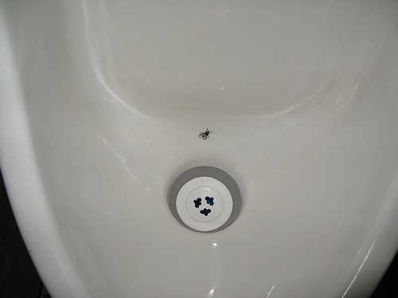
Example 1
http://www.flickr.com/photos/gtzecosan/2920639521/

Slide 7
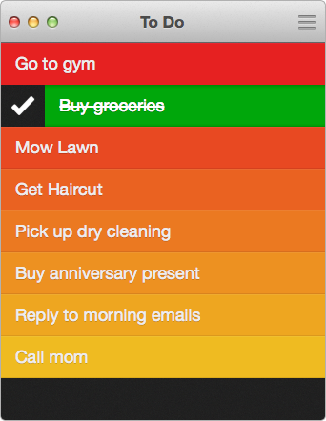
Example 2
http://www.realmacsoftware.com/clear/

Slide 8
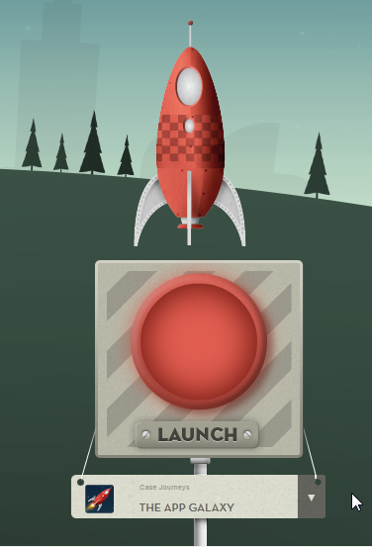
Example 3
Parallax scrolling
http://www.guidetotheappgalaxy.com/

Slide 9
Pretending
Games often allow a player to be another person
Fiction – a different reality. People tend to behave differently if no one knows who they are.
Create your own identity
People love social websites, forums and chat rooms
Choose which parts of you others get to see

Slide 10
Rules
Any game has rules
Rules that define what players can and cannot do
Adams and Rollings:
Six functions defined by game rules:
Semiotics
Gameplay
Sequence of play
Goal(s) of the game
Termination condition
Meta rules

Slide 11
Rules - semiotics
The semiotics of a game are the symbols that are used and how those symbols are interpreted
In Web design, we can look at icons as semiotics.
Our users need to understand the icons that we use
Always consider whether to use an icon, text or both

Slide 12
Rules - gameplay
Gameplay is a combination of
Challenges (i.e. what the player has to overcome)
actions (i.e. what the player has to do in order to overcome the challenges)
Challenges in different levels
Have to suit the player
Probably wouldn’t work on a website…

Slide 13
Rules - sequence of play
The sequence of play can be thought of as the progression of the game
“Run through the level, collect stuff, defeat enemies and hit the flag.”
Same on each level
Web shop
The sequence of play could be Search for product → Read reviews → Click “Buy” → Check out.
If the user have a good experience, they are likely to return to the website to buy again

Slide 14

Rules - goal(s) of the game
While a game often has a main goal
Angry Birds: defeat the pigs
Players are often motivated to set their own goals
Get three stars in all levels

Slide 15
Rules - goal(s) of the game
When you encourage users to complete a task, they are more likely to try to do it.
On websites:
Registering
filling out a profile
signing up for a newsletter
buying a product
Give the user a sense of success
The good experience will satisfy customers and make them return.

Slide 16
Rules - termination conditions
The termination condition defines when the game ends
Web design
The user has completed a task
“Checking out of a store”
We have to ensure that the visitor has had a great experience up to this point, otherwise they will not come back.

Slide 17
Rules - meta rules
Meta rules are exceptions to the rules, defining when the rules do not apply
Web design
Not useful
We need to stick to the rules to ensure that we don’t confuse users.

Slide 18
Cooperation and Competition
Games are more fun when you have someone to play them with.
You can fight against an opponent or collaborate on completing a task.
Example
Spotify; your Facebook stream is filled with music being listened to by your friends.
You can listen to it yourself, comment, like and so on.
Spotify engages you in its product — even if you don’t even use Spotify.

Slide 19
How To Use Gamification In web design?

Slide 20
We are not looking to transform our products into games
We are trying to learn from an industry with an extremely engaged audience
We should adapt the theories to our needs and to the platforms on which we deliver our products
Gamification shouldn’t be something you apply after designing and building your product
Gamification is a part of the design process itself

Slide 21
Tangible User Interfaces
New ways of interacting with the User Interface
Mobile phones
Tablets
Game consoles

Slide 22
Location-Based Websites
Popular games are often location-based
The location of the player affects the game
Websites? – why not

Slide 23
Constructive and Helpful Feedback
In games, we often see direct feedback to our actions
For instance, your guide might interrupt a game that’s not going so well to help you remember how to use some skills that you learned earlier in the game.
Providing feedback to your users
When something goes wrong
Be honest with your users
Help them move on

Slide 24
Don’t Ignore The Content
Content is important
Gamification is just a tool to serve content more digestibly
The product needs to be great, otherwise it won’t matter
Gamification can improve the user experience, but by no means can it create it alone

Slide 25
Engage the Users
In Angry Birds you can earn badges for completing various tasks throughout the game
badges for ranking high
badges for playing longer
hitting a certain number of pigs, etc.
In a Web store, you could
give customers double the value on their first purchase
increase the discount according to how often they buy
There are many ways to engage users.
Ask them for feedback
Create a Facebook page or Twitter profile, and be active

Slide 26
Easter Eggs
Hidden stuff that appears at some point
The Konami Code appeared by mistake in the 1985 arcade game Gradius:
up, up, down, down, left, right, left, right, B, A, Start
Some websites have Easter eggs
http://www.geekandhype.com/

Slide 27
When Not To Use Gamification
Sell the Product, Not the Experience
Websites Shouldn’t Have Difficulty Levels
Don’t Spam. Ever.
Never Force Visitors to Play

